Slide 1

Real Estate Management
Supervised By
Prof. Kalyani Alisetty
Dept. M.C.A.
Presented By
Sahane Shubham Sanjay (Roll-106)
Department of MCA
Sinhgad Institute of Business And Research Pune
1

Slide 2
Introduction
Real Estate Management System Project in PHP focuses mainly on publishing and viewing properties.
To be more precise, the system helps to keep a number of sales and rental properties. Also, the system contains all the buyers, sellers, and agent information
In addition, the system allows adding up the builder’s account too.
This project contains an admin panel and a simple client-side.
In an overview of this web application, the user can simply register in order to use the features.
Cients can search for the property details using the state names. As a result, the system filters out all the available properties with detailed information.
The user can view property details such as name, location, pricing, features, images, floor plans, and more.
In fact, this simple real estate project in PHP exposes the property details to the buyers with the contact information of the sellers.
2

Slide 3
Problem Statements
The current manual system has a lot of paper work. To maintain the records of sale and service manually, is a Time-consuming task.
With the increase in database, it will become a massive task to maintain the database.
Requires large quantities of file cabinets, which are huge and require quite a bit of space in the office, which can be used for storing records of previous details.
The retrieval of records of previously registered patients will be a tedious task.
Lack of security for the records, anyone disarrange the records of your system.
Search for Property Online At a fingertip.
3

Slide 4
Proposed System
Our Real Estate Management System is designed to replace their existing manual paper based system And Makes property finding ,Sales ,Rent advertisement To the Digital System.
The new system is to control the information of Property’s With theirs detail’s and Agent details to contact.
Property availability, Search Property in specific area and Submit our own property advertisement, These services are to be provided in an efficient, cost effective manner,
The goal of reducing the time and resources currently required for such tasks.
The search/retrieval of the properties/flats is much faster than the present system, Hence it cause to saving time for the further work.
4

Slide 5
Objectives
Make a paper based system to digital system.
Make it easy for the Users to search property according to their need’s.
Make it easy for user to advertise their property.
Provide users a simple way to find agent details.
5

Slide 6
Scope Of System
User’s can Submit their own property for listing with their complete detail’s and photo’s
Enforces Proper report Generation at all times.
Search Property at any time at anyware to fullfil need.
A user friendly graphical interface.
Provide Agent Details .
Make an Enquery For Property
Admin manage state and city too so only those address property can be submits.
6

Slide 7
Need Of System
There is always a need of a system that will provide an interactive platform between Authority’s and End User.
This system will reduce the manual operation required for Searching Property by Users, And also generate the various reports for analysis.
Thus, there is a big need of the system, which provides all the above mentioned facilities and more.
7

Slide 8
Page Details :Property Seller, Instalment Calculator
When it comes to projects such as real estate systems, the user should also be able to submit their property for sale, and rental purposes. And there is one. The user has to provide a large number of property details. It includes the name of the property, description, pricing details, locations, number of images, features, and much more. With it, the user can also set the property to feature status(codeastro.com). Talking about the featured status, the website simply lists out the top featured properties in the right-hand sidebar. Not just it, every user can list and manage their posted property in order to manage their status. Additionally, the system contains an important feature; an instalment calculator which helps to figure out the total amount that should be paid by the buyers within the instalment period. For that, the user has to enter the total duration with amount and percentage.
7

Slide 9
Page Details :Admin Panel
An administrator has full control over the system. He/she can manage all the users, states and cities, properties, and so on. Here, each and every section has its own respective details such as name, and other important details. Here, an admin can list out a number of registered users with their levels. The user level consists of admin, agents, builders, and clients. The very first thing of management for the administrator side is to set up state and city information. And with it(codeastro.com), the administrator can also manage properties. In terms of property management, the admin can list out all the available properties. With it, the administrator can make changes to any of the available ones. In fact, the administrator him/herself can post property details following the procedure of it. In addition to it, the admin can have an overview of the system’s record from the dashboard.
7

Slide 10
Page Details :Contact, Feedback Management and Web Info
When it comes to projects such as real estate systems, the user should also be able to submit their property for sale, and rental purposes. And there is one. The user has to provide a large number of property details. It includes the name of the property, description, pricing details, locations, number of images, features, and much more. With it, the user can also set the property to feature status(codeastro.com). Talking about the featured status, the website simply lists out the top featured properties in the right-hand sidebar. Not just it, every user can list and manage their posted property in order to manage their status. Additionally, the system contains an important feature; an instalment calculator which helps to figure out the total amount that should be paid by the buyers within the instalment period. For that, the user has to enter the total duration with amount and percentage.
7

Slide 11
Available Features:
Client-Side
Admin Panel
Register as User/Agent/Builder
Submit Property Details
List and Manage Properties
Search Properties
Instalment Calculator
Feature Properties
Seller Details
Send Feedbacks
Manage Testimonials
User Management
Manage State & City
Contact Queries
Feedback Management
Manage About Page
Overall System Information
Agent Section

Slide 12
Requirements
Hardware Requirement:
Processor : Intel CORE i5 8th Gen
Memory : 4GB (or) Higher
Hard Disk : 80GB (or) Higher
Software Requirement:
Technology used : PHP(7.4), Apache(2.4) ,
Database Server : MySQL 5.7
Operating system : Windows 10/Linux
8

Slide 13
Future Plan
Adding more for agent and builder.
Making this system more robust
Adding state and city from all over country
Adding feacture Rent payment and book property on rent online
10

Slide 14
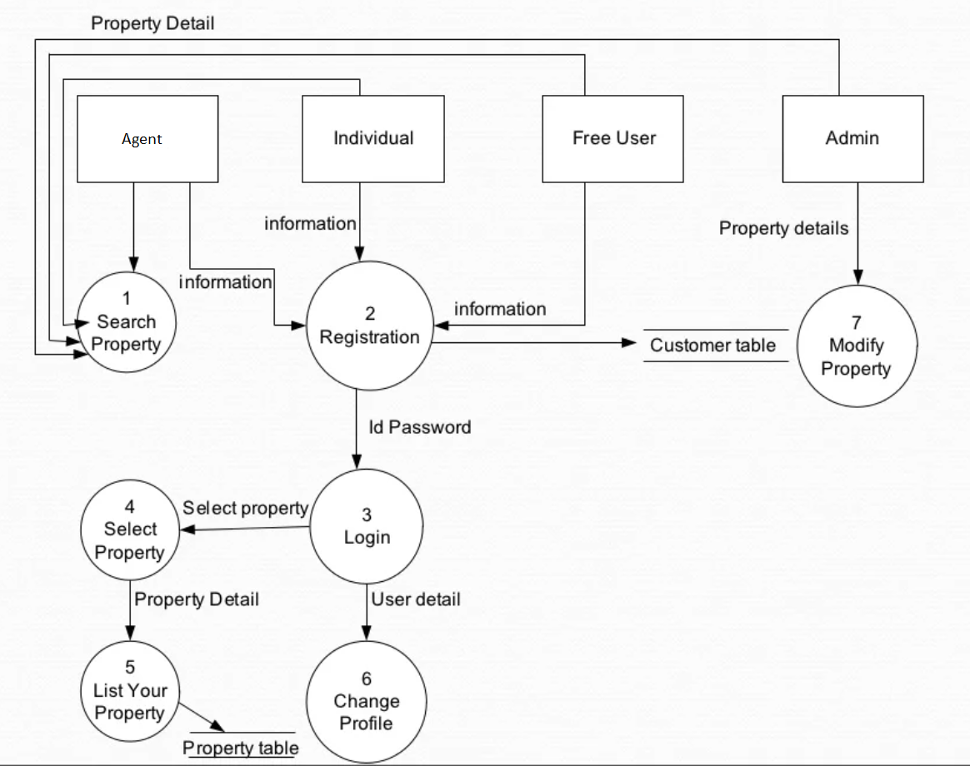
DFD
11

Slide 15
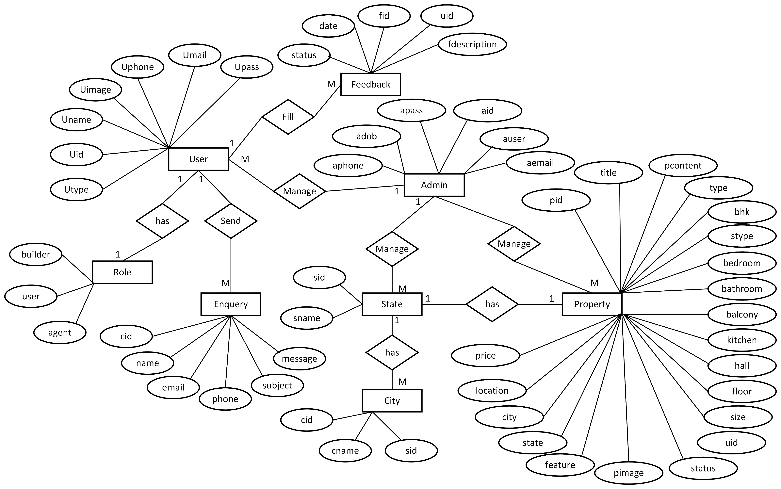
ERD
12

Slide 16
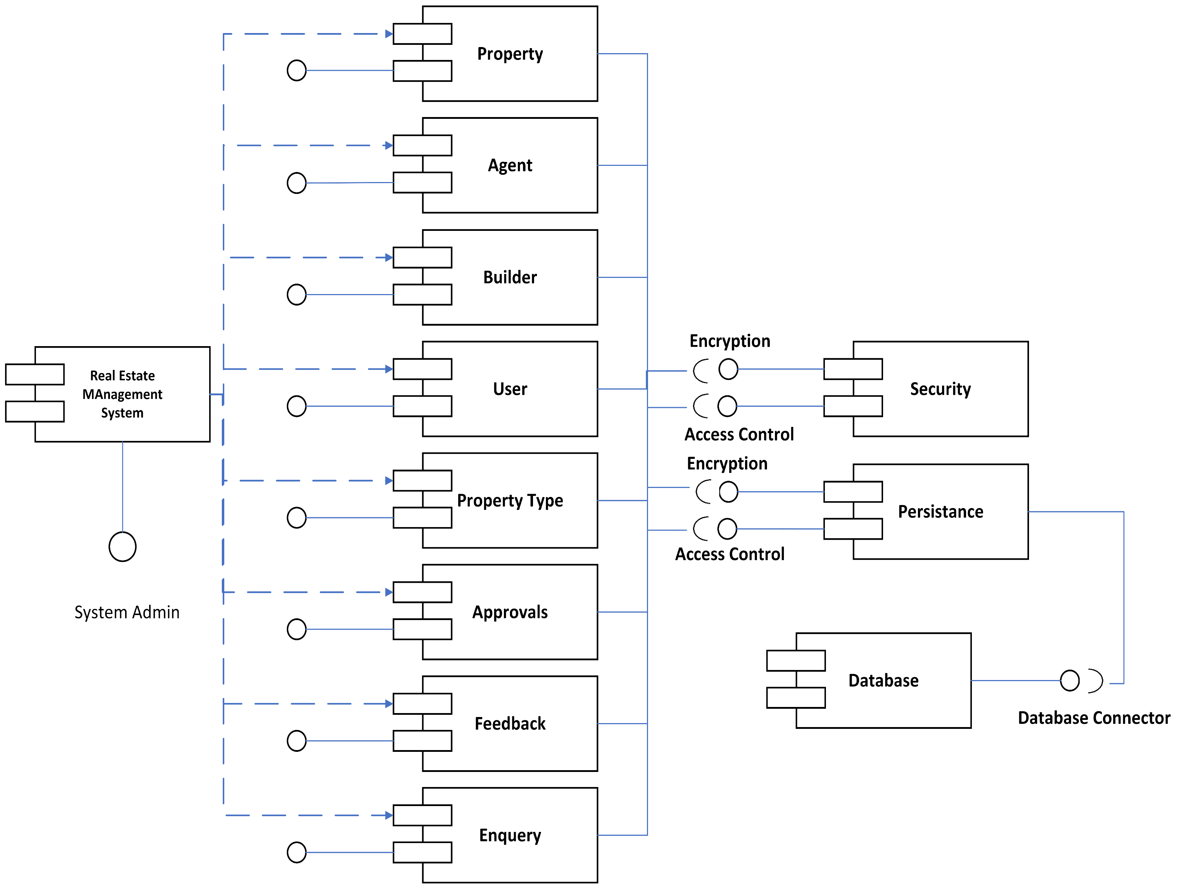
Component Diagram
12

Slide 17
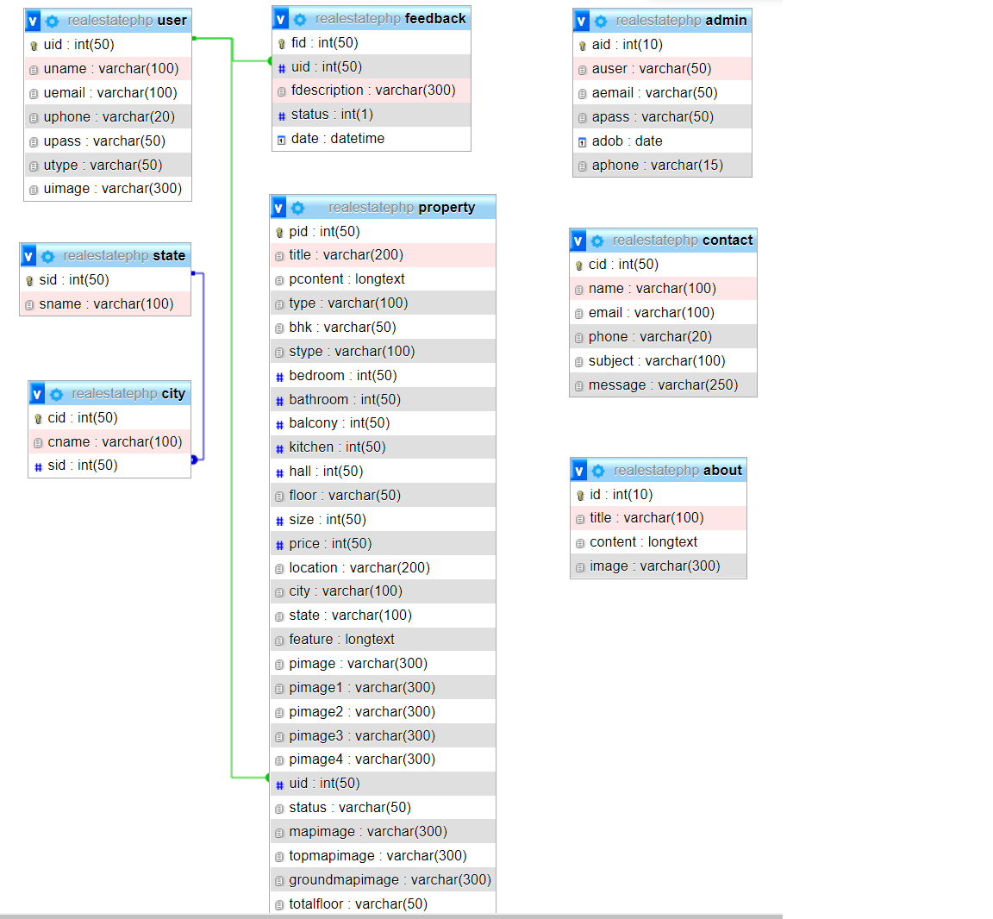
Object Diagram
12

Slide 18
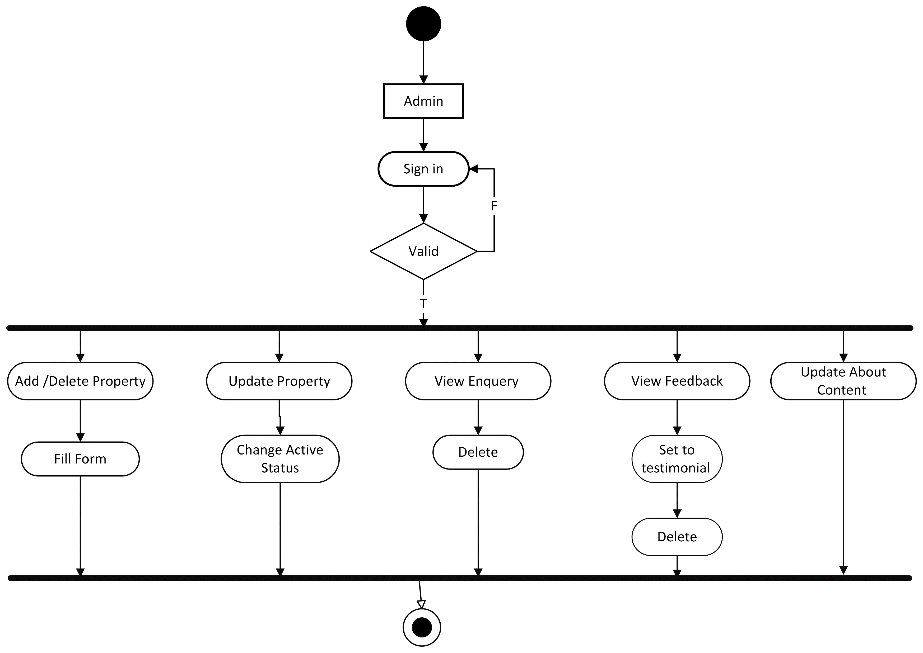
Activity Diagram :admin
12

Slide 19
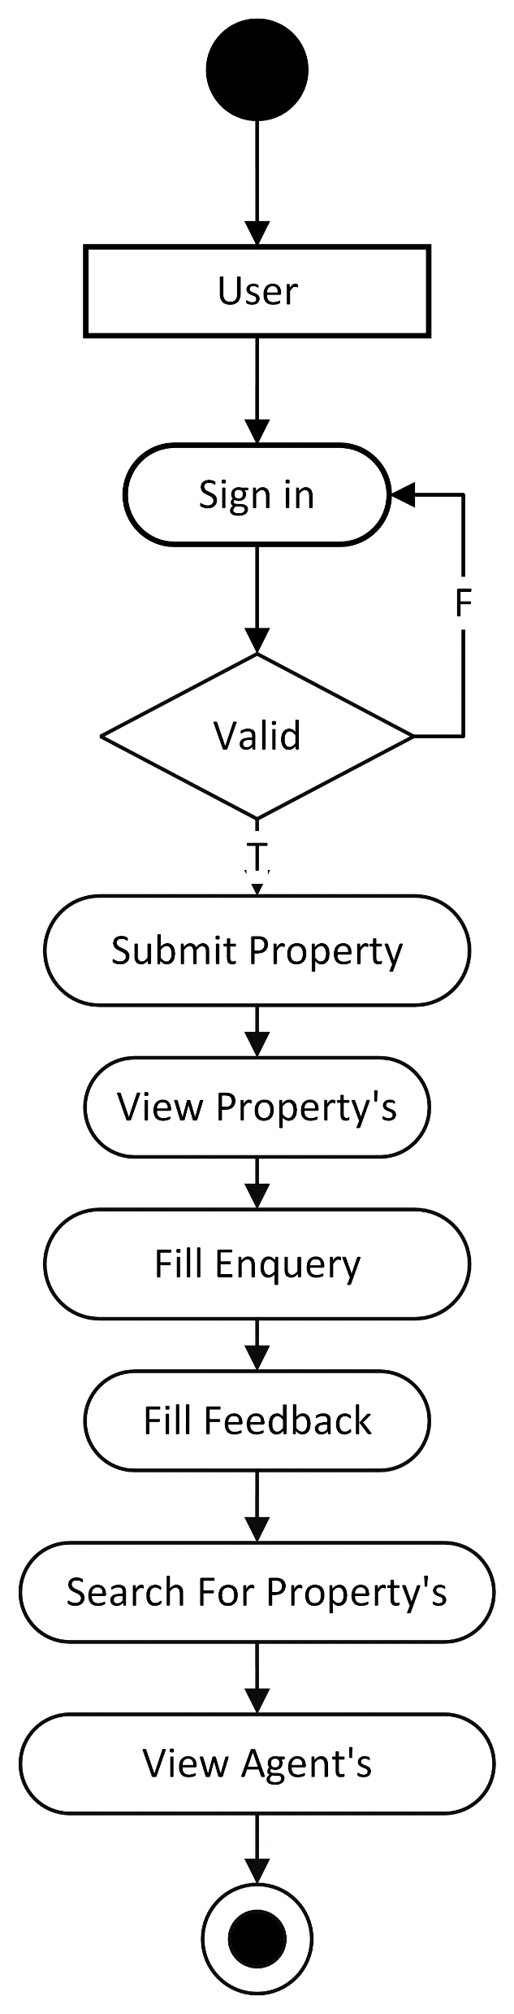
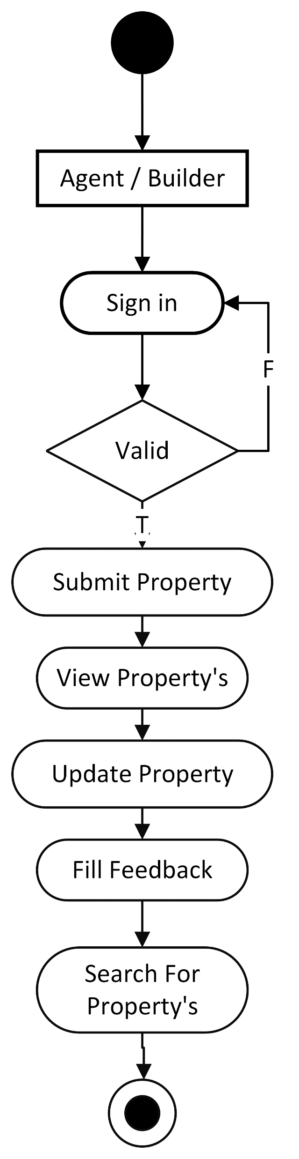
Activity Diagram: Agent,User
12

Slide 20
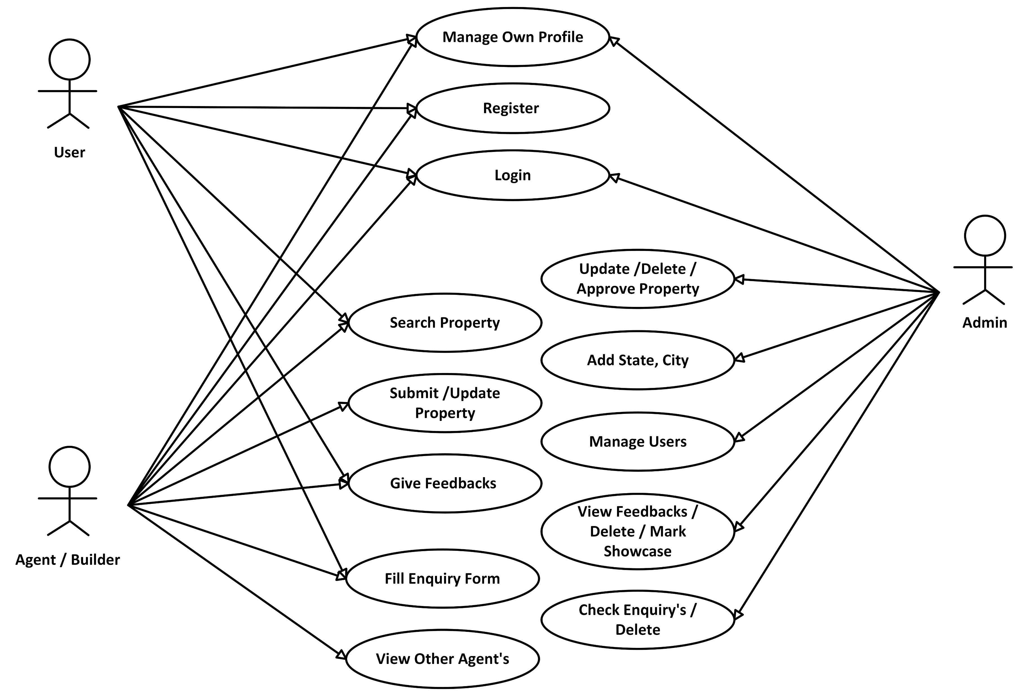
Use Case Diagram:
12

Slide 21
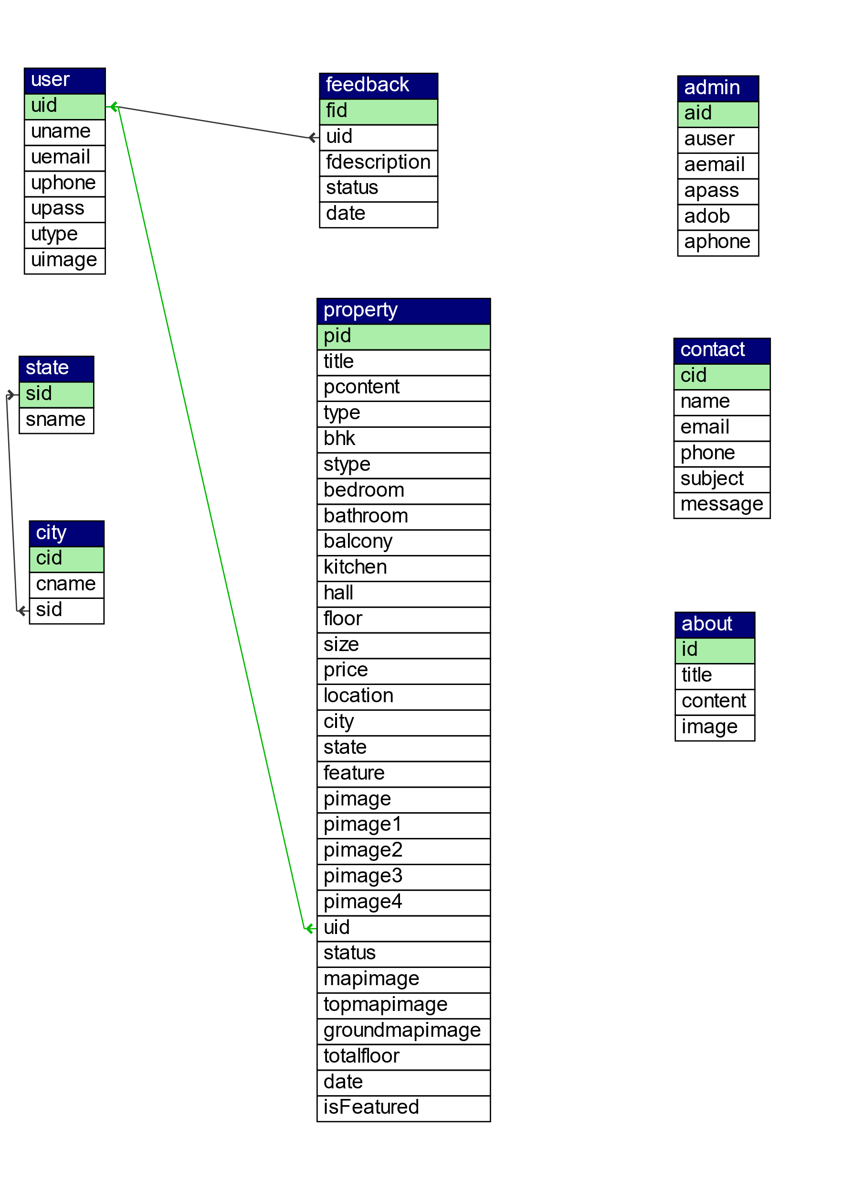
Class Diagram:
12

Slide 22
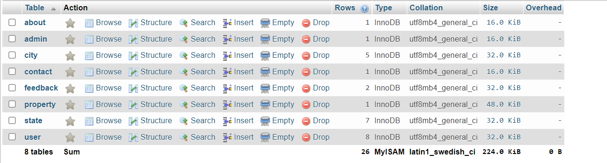
Database :
13

Slide 23
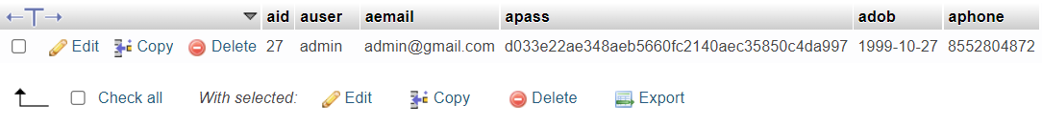
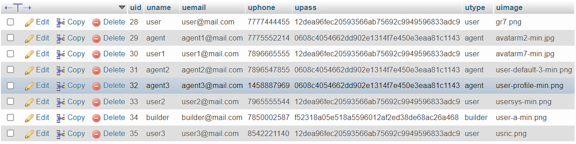
Table :Admin
Table :User
13

Slide 24
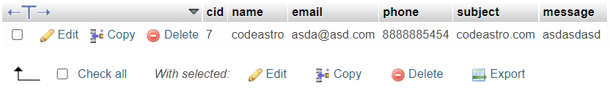
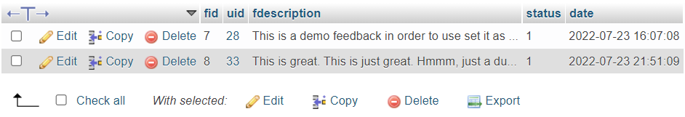
Table :Contact
Table :Feedback
13

Slide 25
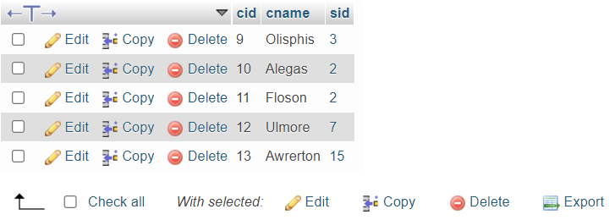
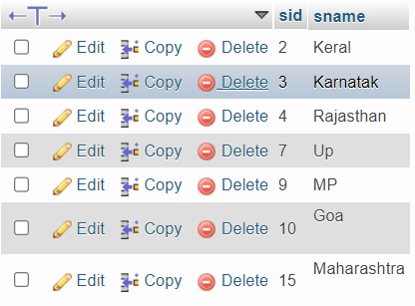
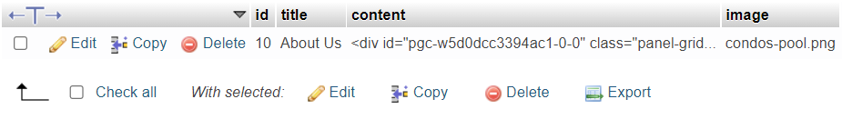
Table :City
Table :State ,About
13

Slide 26
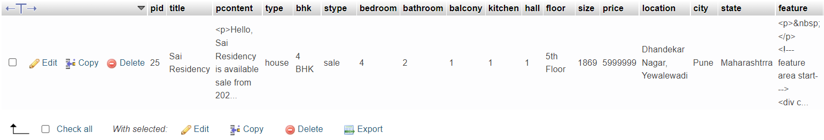
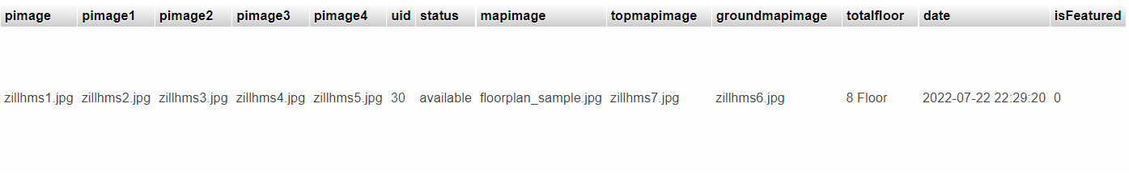
Table :Property
13

Slide 27
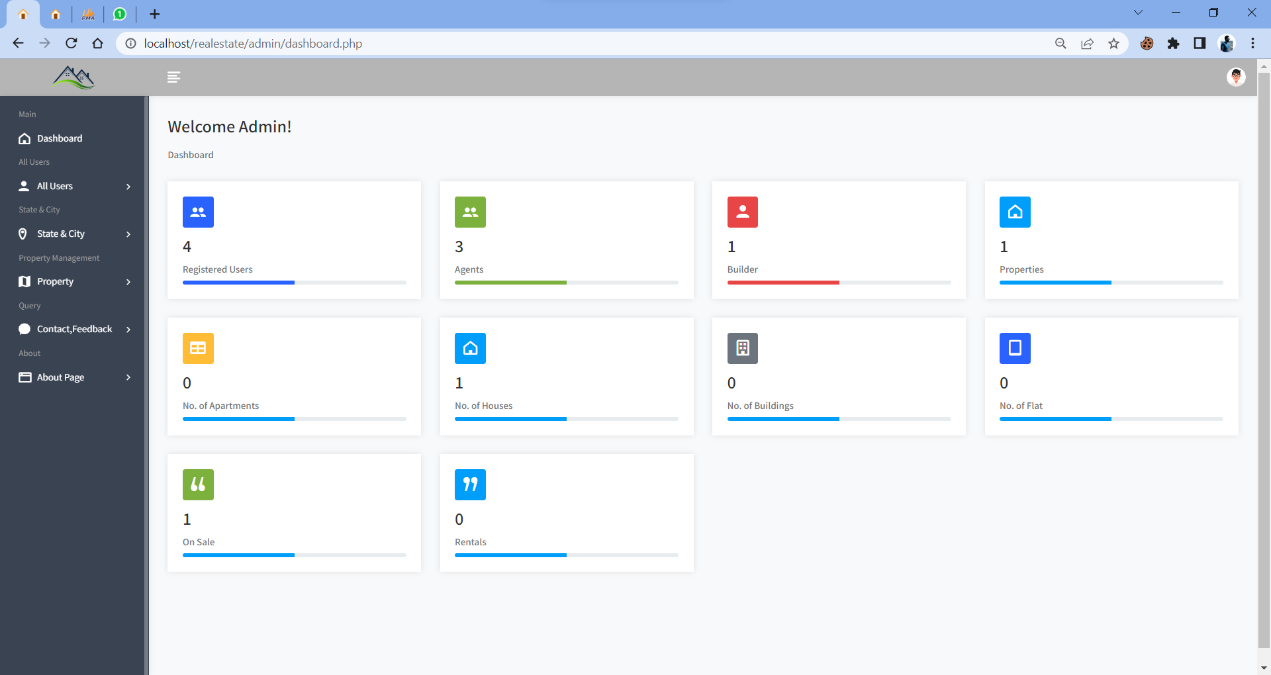
System Screenshot :Admin Home
14

Slide 28
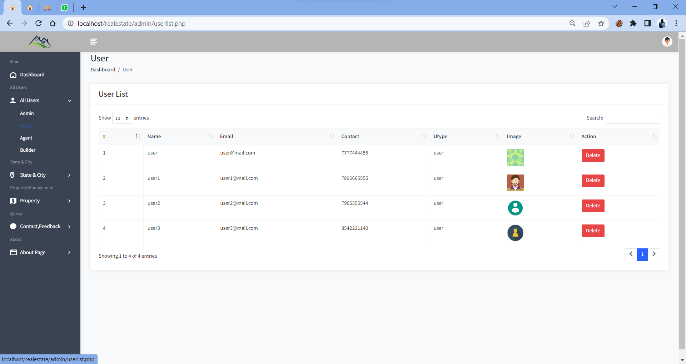
System Screenshot :Manage User’s
14

Slide 29
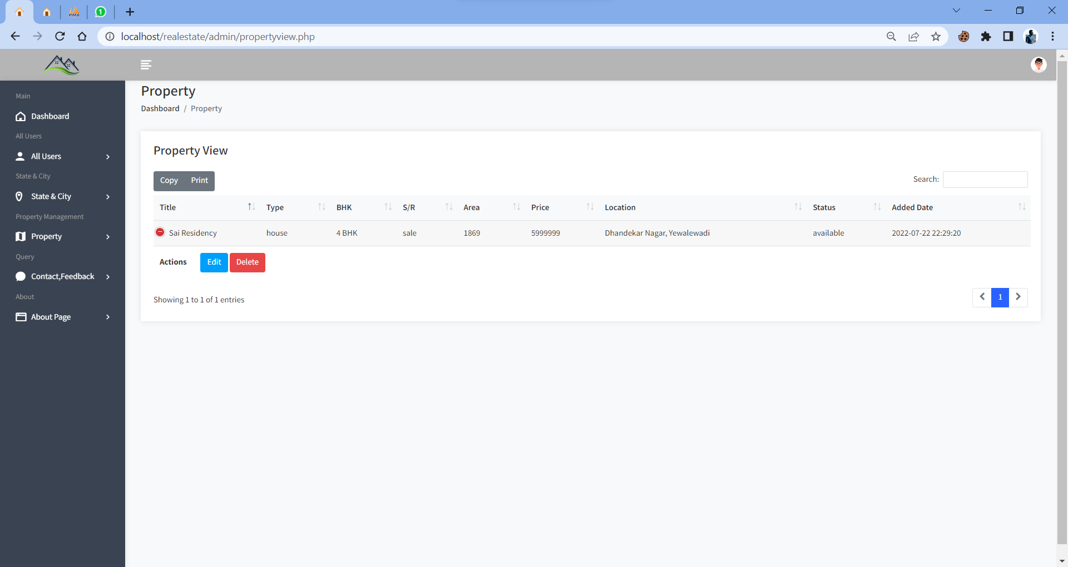
System Screenshot :Manage Property
14

Slide 30
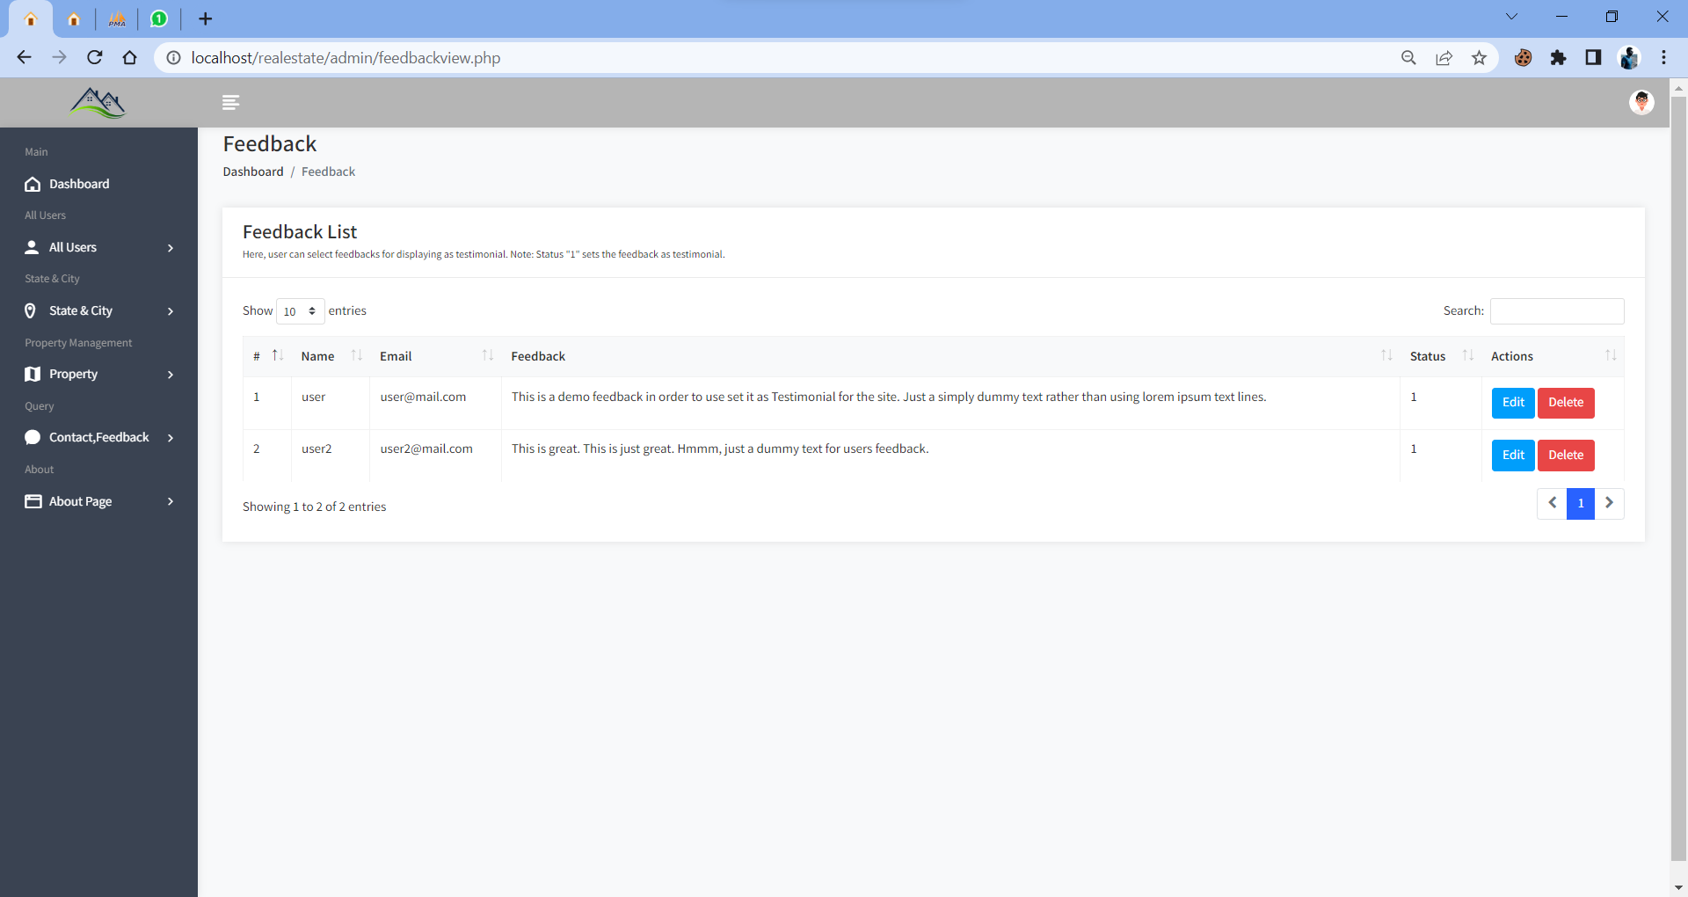
System Screenshot :Manage Feedback
14

Slide 31
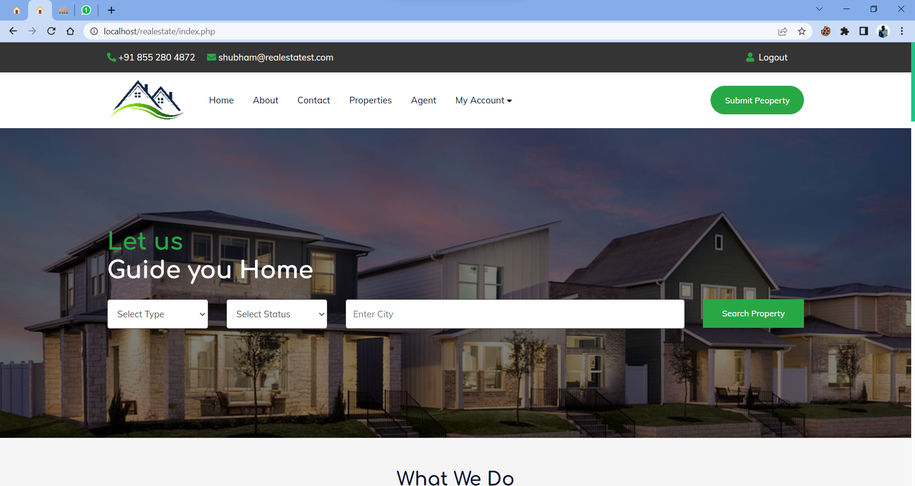
System Screenshot :User Home
14

Slide 32
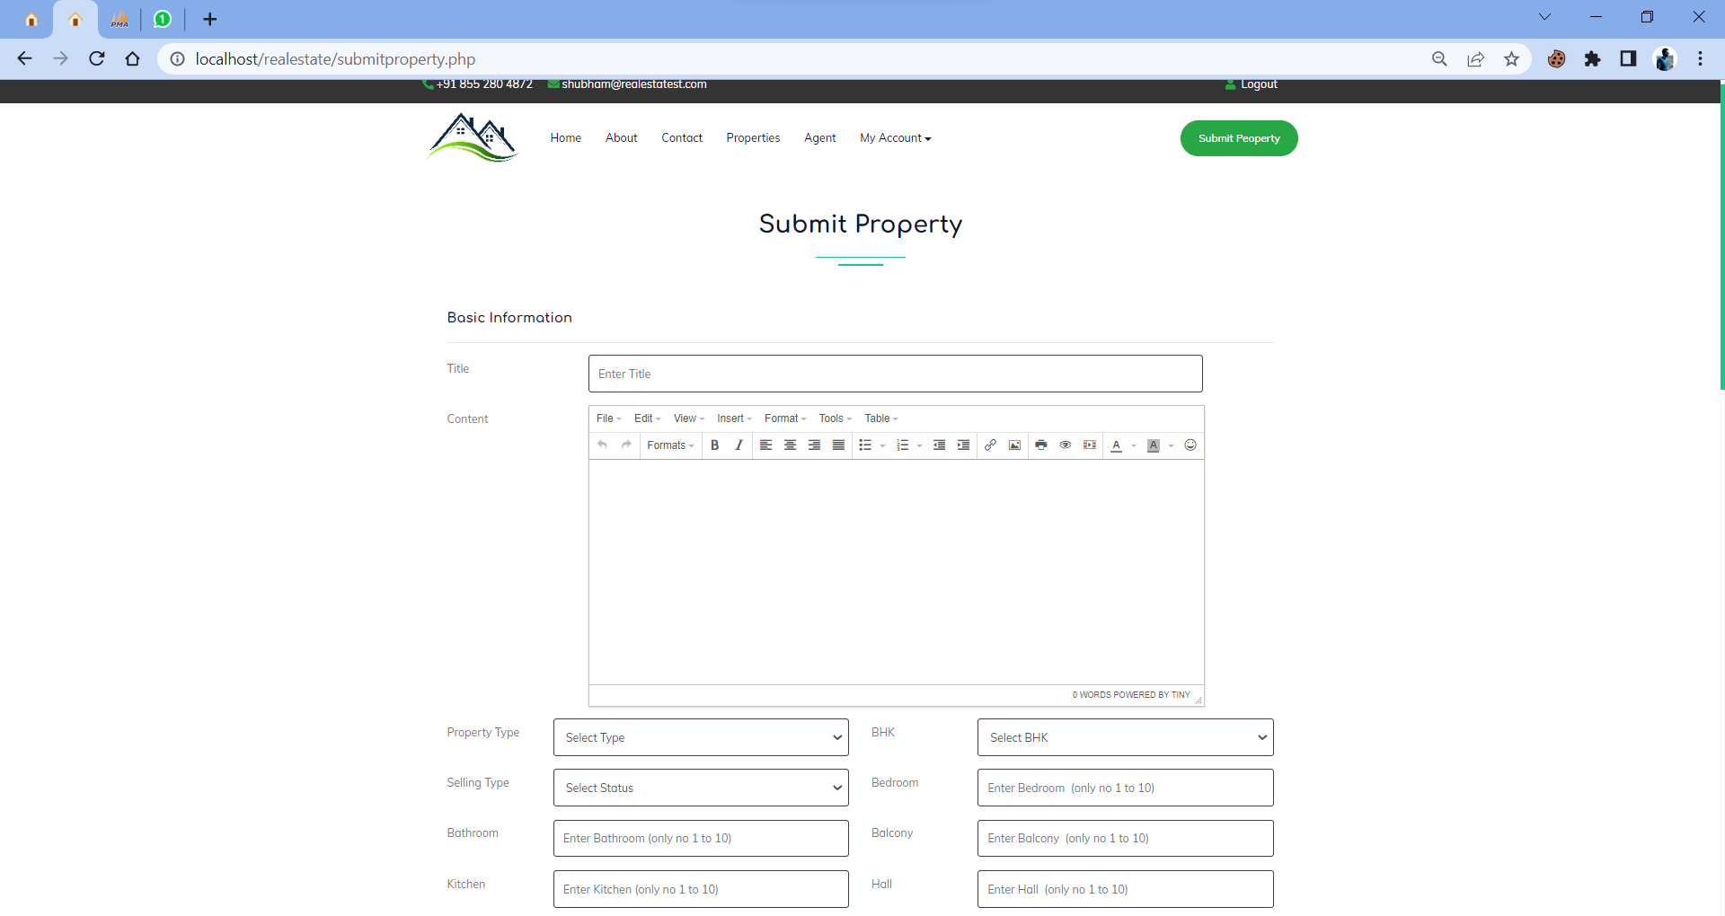
System Screenshot :Submit Property
14

Slide 33
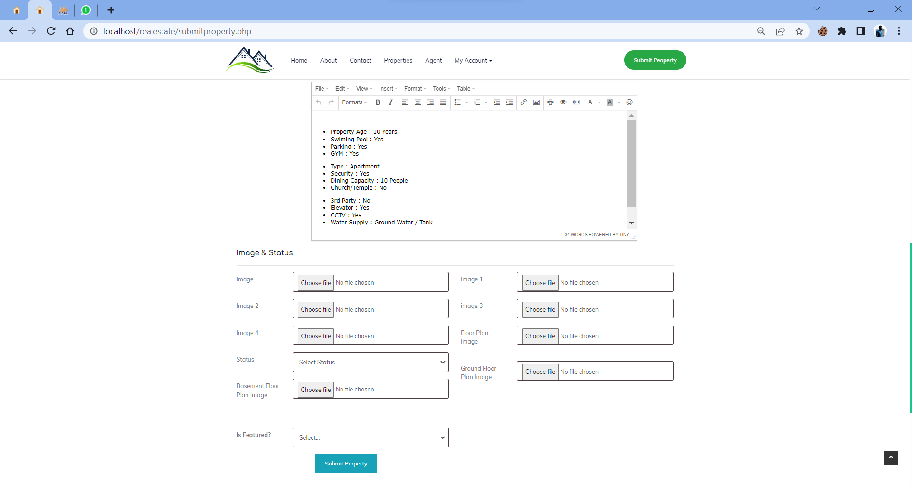
System Screenshot :Submit Property
14

Slide 34
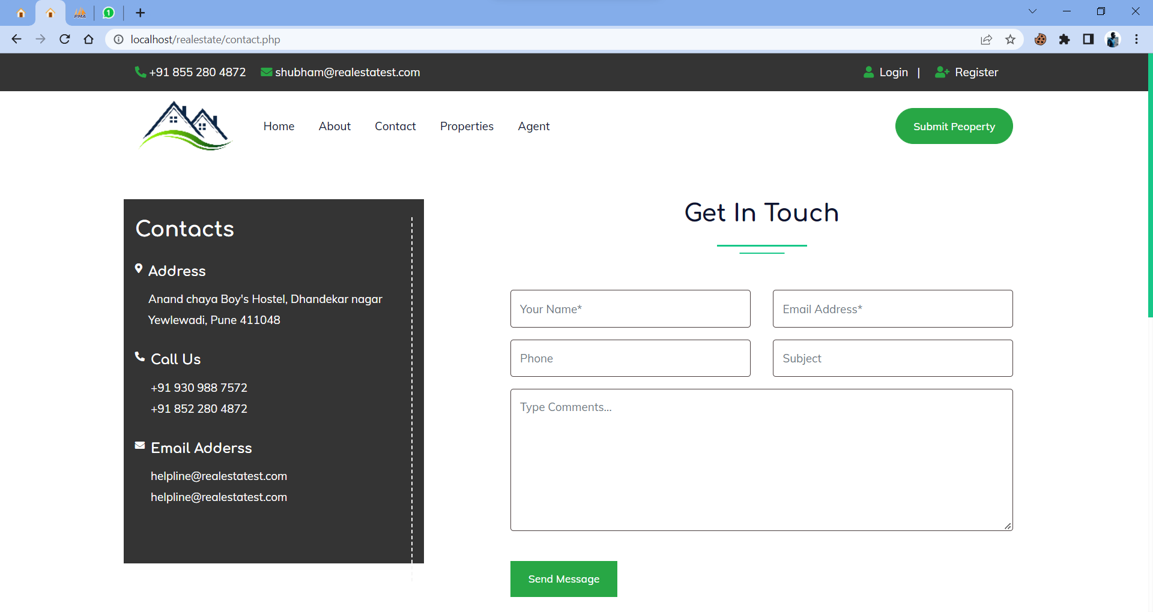
System Screenshot :Contact
14

Slide 35
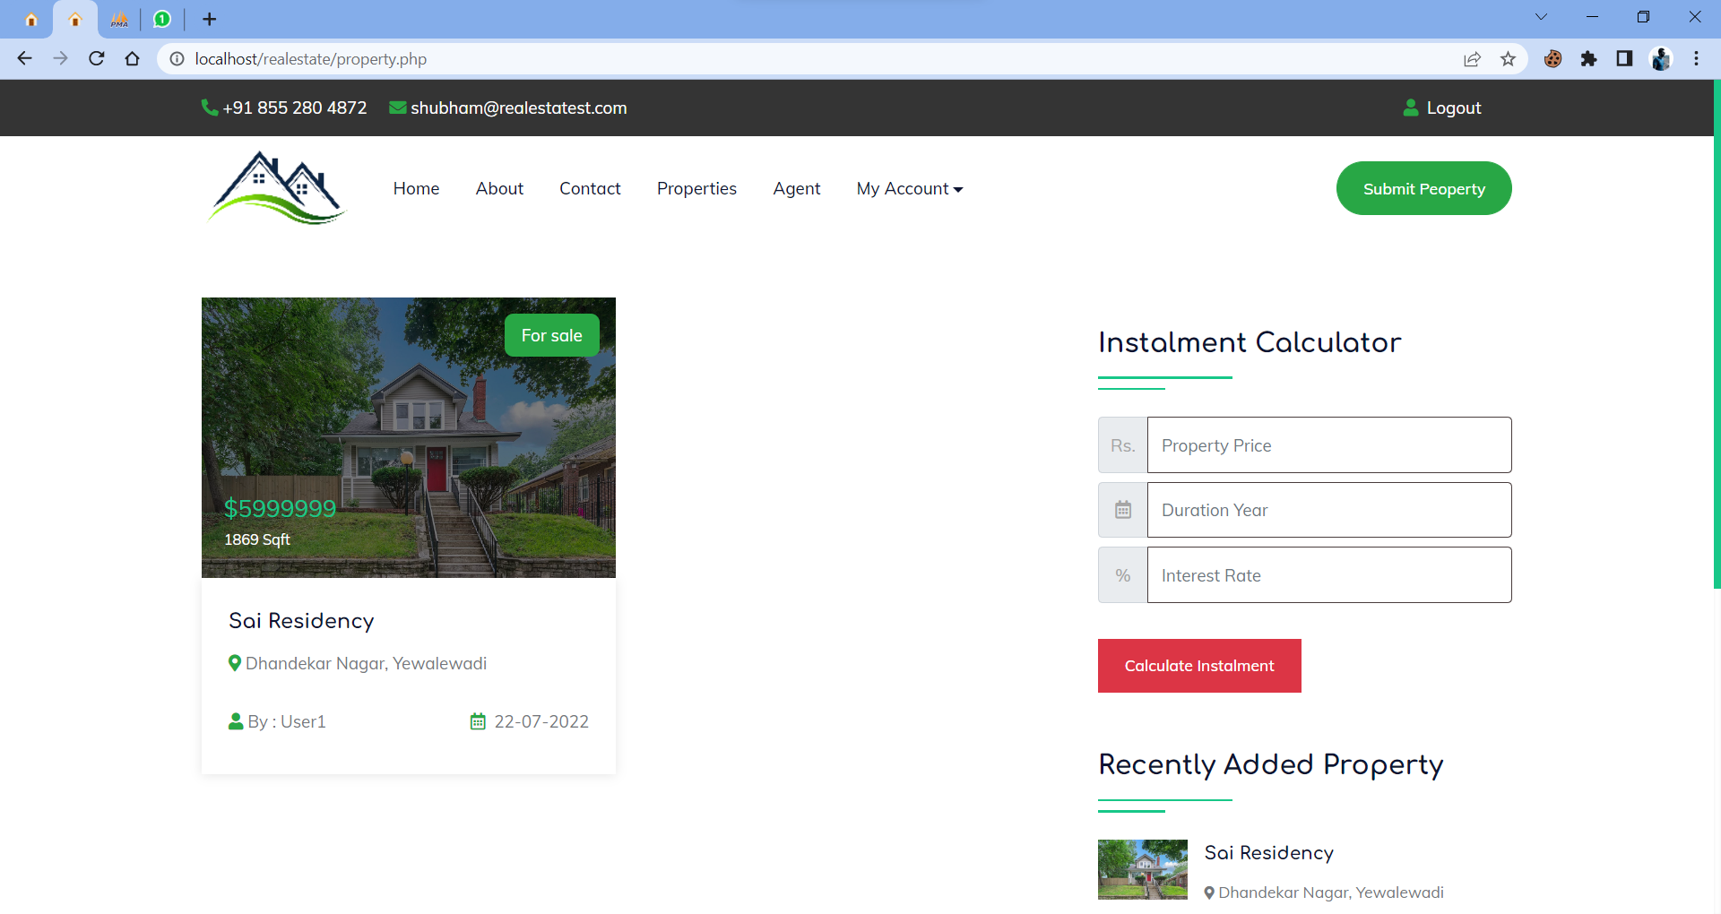
System Screenshot :Property
14

Slide 36
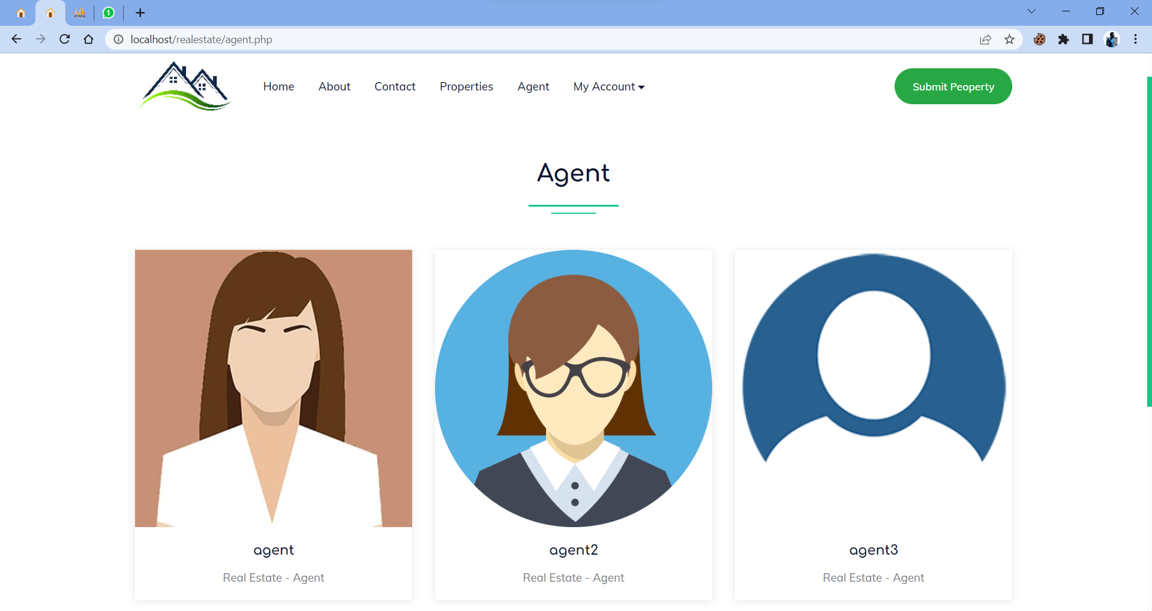
System Screenshot :Agent
14

Slide 37
Bibliography
https://dev.mysql.com/doc/
https://getbootstrap.com/docs/5.2/getting-started/introduction/
https://www.php.net/docs.php
https://www.w3schools.com/html/default.asp

Slide 38
Any Questions??
19

